Slide 1
Ajitha S
FINAL PROJECT
3/21/2024 Annual Review

Slide 2
PROJECT TITLE :Traffic sign recognition using CNN and keras
3/21/2024 Annual Review

Slide 3


AGENDA
Problem Statement
Project Overview
End Users
Our solution and Proposition
Key Features
Modelling Approach
Results and Evaluation
Conclusion
3/21/2024 Annual Review

Slide 4

PROBLEM STATEMENT
Develop a robust traffic sign recognition system using Convolutional Neural Networks (CNNs) implemented with the Keras library.
3/21/2024 Annual Review

Slide 5
PROJECT OVERVIEW
Design and train a CNN model using Keras to effectively classify traffic signs from a labeled image dataset.
Achieve high accuracy in recognizing a diverse set of traffic signs, including variations in size, color, and lighting conditions.
Explore techniques for improving model robustness to real-world challenges like occlusions and varying image quality.
3/21/2024 Annual Review

Slide 6

WHO ARE THE END USERS?
.
Fleet Operators
Transportation Authorities
Urban Planners
Pedestrians and Cyclists
Smart City Initiatives
Automotive Engineers
Road Maintenance Crews
3/21/2024 Annual Review

Slide 7

YOUR SOLUTION AND ITS VALUE PROPOSITION
This solution leverages Convolutional Neural Networks (CNNs) implemented with the Keras library to develop a robust system for traffic sign recognition.
Development of ADAS and Autonomous Vehicles: This solution provides a vital building block for intelligent transportation systems and self-driving cars.
Enhanced Traffic Management: Real-time traffic sign information can be used to optimize traffic flow, reduce congestion, and improve overall traffic efficiency.
Improved Road Safety: Accurate traffic sign recognition can assist drivers and autonomous vehicles in obeying traffic regulations, leading to fewer accidents.
3/21/2024 Annual Review

Slide 8

THE WOW IN YOUR SOLUTION
Real-Time Recognition for Immediate Action
Adaptability to Evolving Traffic Landscapes
Scalability for Widespread Traffic Network Coverage
Foundation for Advanced Traffic Analysis
3/21/2024 Annual Review
8

Slide 9
MODELLING
Modeling for the Traffic Face recognition Using CNNs and Keras:
Data Collection: Gather a diverse dataset of labeled traffic sign images, capturing various angles, lighting conditions, and backgrounds. Ensure that the dataset includes a wide range of traffic sign types and variations to support robust model training. Data Preprocessing: Preprocess the dataset by resizing images to a uniform size, normalizing pixel values, and augmenting the dataset with techniques like rotation, flipping, and scaling. Additionally, split the dataset into training, validation, and test sets to evaluate model performance. Model Architecture Design: Design a CNN architecture suitable for traffic sign recognition tasks. Start with a baseline architecture such as LeNet, VGG, or ResNet, and customize it based on the complexity of the dataset and computational resources available. Model Training: Train the CNN model using the preprocessed dataset. Use techniques like mini-batch stochastic gradient descent (SGD) or Adam optimization to update model parameters iteratively. Monitor training progress using metrics such as loss and accuracy.
3/21/2024 Annual Review
9

Slide 10
MODELLING
Model Evaluation: Evaluate the trained model's performance on the validation set to assess its generalization ability. Measure metrics such as accuracy, precision, recall, and F1-score to quantify the model's effectiveness in recognizing traffic signs.
Hyperparameter Tuning: Fine-tune the model's hyperparameters, including learning rate, batch size, dropout rate, and number of layers, to optimize performance further. Experiment with different configurations using techniques like grid search or random search.
Deployment: Deploy the trained CNN model into real-world applications, such as traffic surveillance cameras or autonomous vehicles. Integrate the model into the target environment, ensuring compatibility with input image formats and real-time processing requirements.
Monitoring and Maintenance: Continuously monitor the deployed model's performance and update it as needed to adapt to changing traffic conditions, new sign types, or improvements in model architecture. Regularly retrain the model using updated datasets to maintain optimal performance over time.
3/21/2024 Annual Review
10

Slide 11
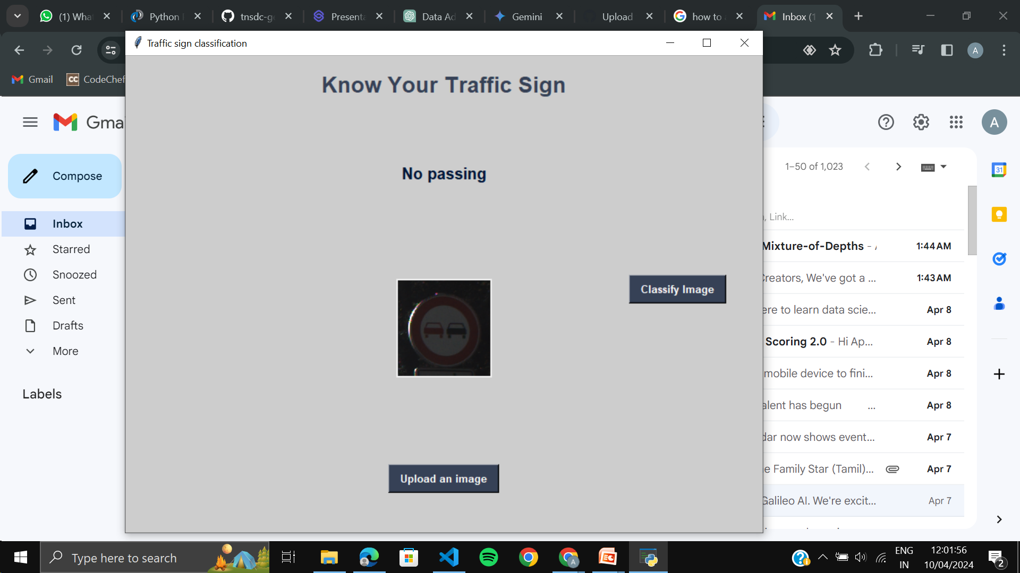
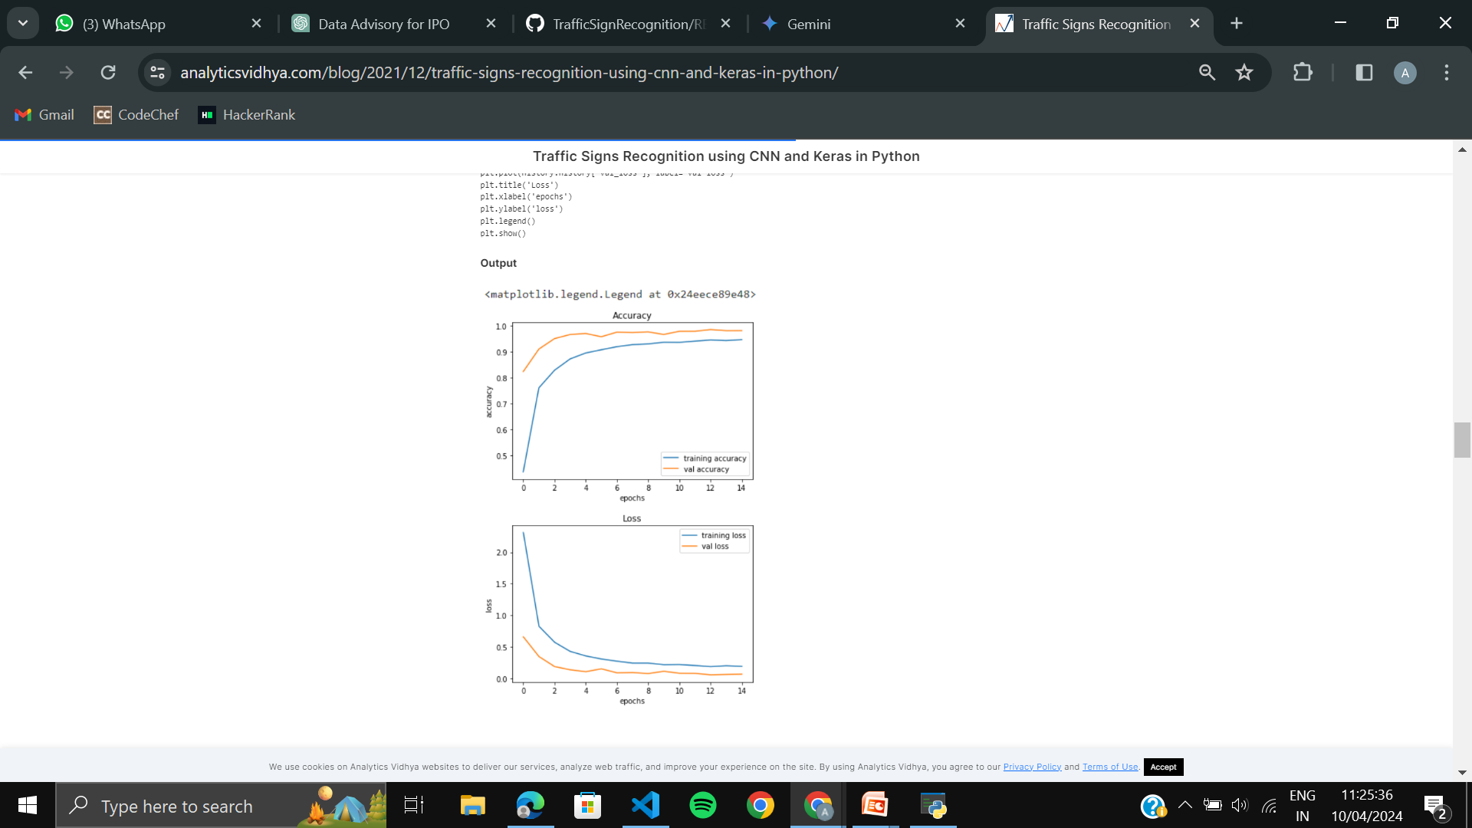
RESULTS
3/21/2024 Annual Review
11

